Slide 1
Abstraction
Course Code: CSC1102 &1103
Course Title: Introduction to Programming
Dept. of Computer Science
Faculty of Science and Technology
Lecturer No: |  | Week No: |  | Semester:
Lecturer: | MD. MAZID-UL-HAQUE

Slide 2
Lecture Outline
Abstraction
Data Abstraction
Other ways:
* Abstract Class
* Abstract Function (Pure Virtual Method)

Slide 3
Abstraction
Definition of Abstraction
It means ‘Hiding the Details and showing only the necessary things.’.
It is a process where implementation is hidden and its functionality is shown to user.

Slide 4

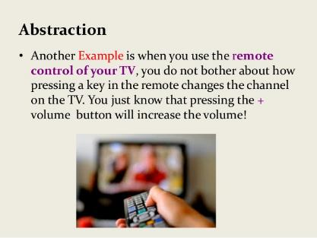
Abstraction
Example of Abstraction
Real Life Example:

Slide 5
Abstraction
In programming, this concept of hiding the details is known as abstraction.
We can hide the details of a class or a function.
Data Abstraction in C++
Other ways:
Abstract Class
Abstract Function (In C++ known as Pure Virtual Method)

Slide 6
Data Abstraction
What is Data Abstraction?
Data abstraction refers to providing only essential information about the data to the outside world, hiding the background details or implementation.
How to achieve data abstraction?
Abstraction using classes
Abstraction using header files.

Slide 7
Data Abstraction
Abstraction using classes
We can implement Abstraction in C++ using classes.
Class helps us to group data members and member functions using available access specifiers.
A Class can decide which data member will be visible to outside world and which is not. We can achieve it using access specifier.

Slide 8
Data Abstraction
Access specifiers
In C++, we have 3 access specifiers.
Public: members can be accessed from outside of the class
Private: members can be accessed from outside on the class. It is only accessible only from the containing class.
Protected: members cannot be accessed from outside the class, however, they can be accessed in inherited classes.

Slide 9
Data Abstraction (Example-using class)
#include<iostream>
using namespace std;
class implementAbstraction
{
private: ///Private members
int a,b;
public:
void set(int x, int y ) ///method to set values of private members
{
a=x;
b=y;
}
void display()
{
cout<<"a= " <<a << endl;
cout<<"b= " << b << endl;
}
};
int main()
{
implementAbstraction obj;
obj.set(10, 20);
obj.display();
return 0;
}
User just know that there is two function named set and display to access two data/variables, but will not be able to directly access them.

Slide 10
Data Abstraction
We can see in the above program we are not allowed to access the variables a and b directly as this is a private member of this class, however one can call the function set() to set the values in a and b and the function display() to display the values of a and b. But a and b can’t be accessed directly from the main method. So, a and b are hidden from the outside of the class. So, this is an abstractions.

Slide 11
Data Abstraction
Abstraction using header file
One more type of abstraction in C++ can be header files. For example, consider the pow() method present in math.h header file. Whenever we need to calculate power of a number, we simply call the function pow() present in the math.h header file and pass the numbers as arguments without knowing the underlying algorithm/logic according to which the function is actually calculating power of numbers.

Slide 12
Data Abstraction (Example-using header file)
#include<iostream>
#include<math.h> ///Imported math header
using namespace std;
int main()
{
int A;
int power;
cout << "Enter a number: " ;
cin>> A;
cout << "Enter power: ";
cin >> power;
int Power_of_A= pow(A, power); ///pow()
cout <<A<<"^"<<power<<"= "<<Power_of_A;
return 0;
}
User knows there is a function named “pow” in the header file, but does not know the detailed implementation of this “pow“ function

Slide 13
Other ways

Slide 14
Abstract Function (Pure Virtual Function)
A pure virtual function (or abstract function) in C++ is a virtual function for which we can have implementation, but we must override that function in the derived class, otherwise the derived class will also become abstract class. So, in the base class it (pure virtual function) have no implementation or the detail of the function is hidden on the base class.

Slide 15
Abstract Function (Pure Virtual Function)(Example)
#include<iostream>
using namespace std;
class Base
{
int x;
public:
virtual void fun() = 0; ///Pure virtual function
///Abstract function
int getX()
{
return x;
}
};
/// This class inherits from Base and implements fun()
class Derived: public Base
{
int y;
public:
void fun() ///Implemented Pure virtual/Abstract function
{
cout << "fun() called";
}
};

Slide 16
Abstract Class
What is abstract class?
By definition, an abstract class in C++ is a class that has at least one pure virtual function (i.e., a function that has no definition).
We can’t create instance/object of a abstract class directly. However pointers and references of Abstract class type can be created.

Slide 17
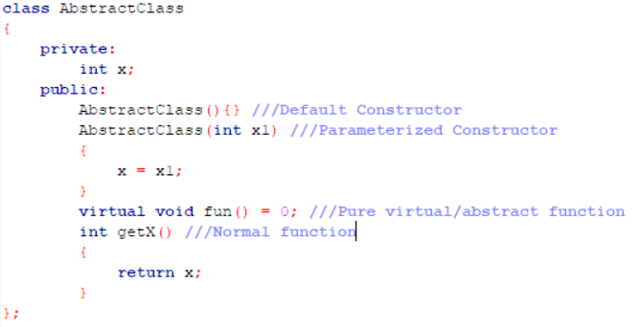
Abstract Class
What an abstract class can contain?
An abstract class may have regular function.
An abstract class must have at least one pure virtual function.
An abstract class may have attributes.
An abstract class may have constructors.

Slide 18
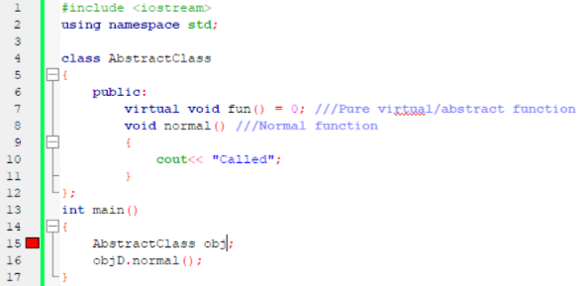

Abstract Class
We can’t create instance/object of a abstract class.

Slide 19
Accessing Abstract Function and Class
We can access both abstract function and class by inheritance.
We have to inherit the abstract class by another class and have to implement the abstract function (pure virtual function) on it.
Then we can access the abstract function and all the public and protected members of the abstract call from the child class (the class which inherits the abstract class).
From that we will able to create pointers and references of Abstract class.

Slide 20
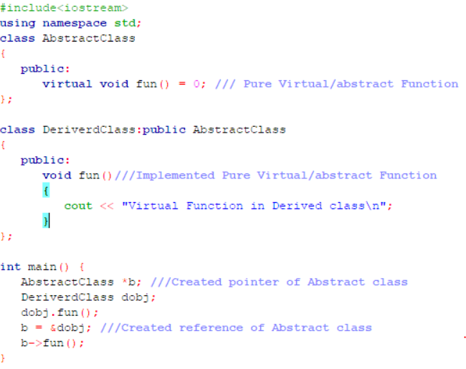
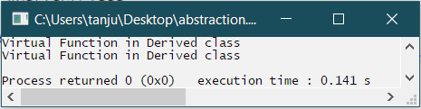
Accessing Abstract Function and Class (Example)

